Slide 1
Unix Competency Presentation
by Amy Leota Shropshire
LS 560 – Dr. Bonicci – Spring 2016

Slide 2
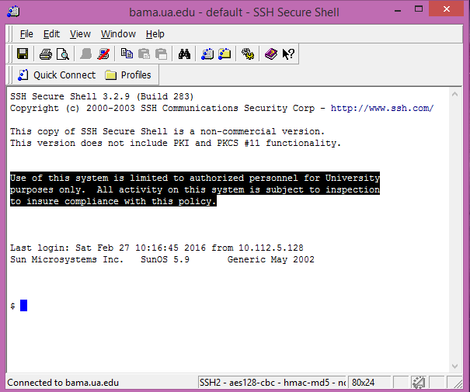
Unix Presentation – Competency 1 Logging in
Command – With my windows machine, the quick connect button does the work of the command.
Usefulness – This command enables the user to log into the Unix system. It enables the user to utilize all the other Unix commands in this presentation. It allows the user to access a secure server, and manipulate files and permissions on the secure server.

Slide 3
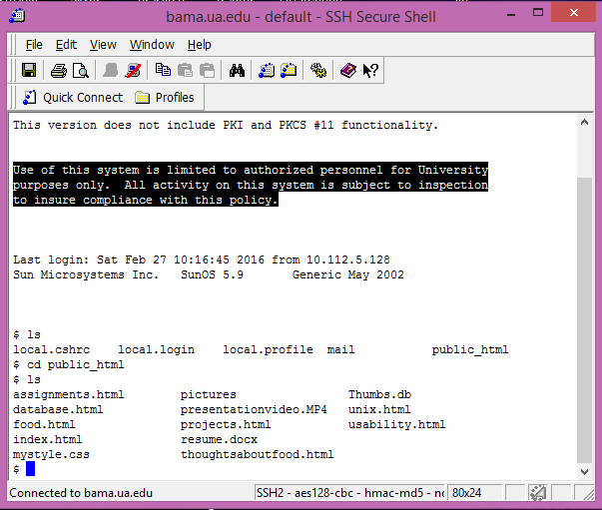
Unix Presentation – Competency 2 Changing directory
Command – The {cd} command allows the user to change the directory within which interaction with the server is taking place.
Usefulness – This command is crucial, because it conceptualizes the directory and file structure as a browsable substrate, within which the user can move effectively. The user can “relocate” to a directory in question, in order to more effectively browse and discover the nuances of the file structure and details of structural design.

Slide 4
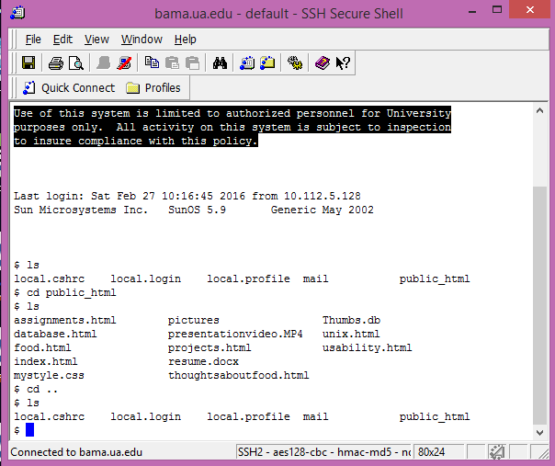
Unix Presentation – Competency 3 Backing out of a directory
Command – The {cd ..} command, in the example shown allows the user to “back up” in spatial terms, and return to the parent directory within which they have browsed. Alternately, when jumping straight to the root directory {cd} can be used as a standalone function to return to the root.
Usefulness – This function allows the user to spatially “back put” and “zoom in” again in order to compare files and directory structures. It is useful, not only for the establishment of spatial relationships for browsability, but also as a method of returning to previous points in the navigation for working more efficiently within the system.

Slide 5
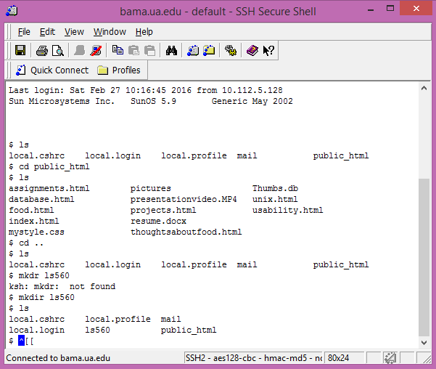
Unix Presentation – Competency 4 Creating a new directory
Command – The command {mkdir} followed by a directory name allows the user to create a new file directory, or a new folder within which to work.
Usefulness – This command begins to empowers the user to organize and alter the structure of the file directory, so that organizational sense can be maintained, without having to transfer and upload the same information again, simply to organize the file structure.

Slide 6

Unix Presentation – Competency 5 Moving into created directory
Command – The {cd} command is utilized here again to move within a created directory.
Usefulness – Like the previous instance of the {cd} command, this example provides spatial reasoning and browsability of a directory structure. This example proves the universality of Unix commands, which apply non-contextually, to both existing and newly created file structures, and truly demonstrates the power inherent in the Unix server, and how much power is invested in each particular user.

Slide 7
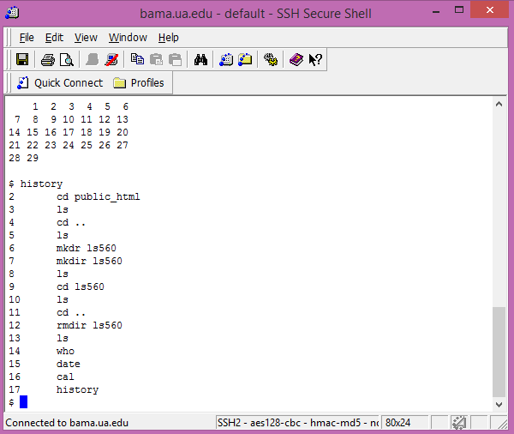
Unix Presentation – Competency 6 Display last 10 commands
Command – The {history} command displays the last ten commands entered by the user entering the command, even those entered in error, as demonstrated.
Usefulness – As a learning tool, this is possibly the most useful. It is useful for the user’s own replication of results, and also for teaching others to utilize the appropriate commands to achieve a given result.

Slide 8

Unix Presentation – Competency 7 Display current date and time
Command – {date} allows the user to display the current date and time.
Usefulness – This command enables the user to quicly and efficiently check the date and time the server clock has. It can be useful as a means to synchronize timing with the server, as well as to check for any errors involving temporal anomalies on websites with timed features. It also allows the user to verify the settings of the server compared to their personal time zone and adjust accordingly.

Slide 9

Unix Presentation – Competency 8 Display users logged on
Command – The aptly named {who} command enables the user to visually verify who else is logged into the server.
Usefulness – This feature allows the user to effectively coordinate if involved in team operations, by verifying which users are logged in synchronously. It also allows the user to view the IP addresses of those other users, and could thus be useful for locating or aiding others with technical difficulties. The user has the ability to see how many users are logged on at a given time, in order explain possible bandwidth concerns, and to verify that changes being made online are being done by credentialed sources.

Slide 10
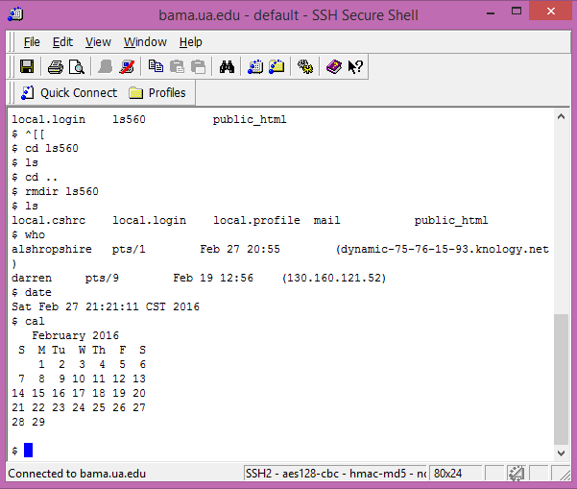
Unix Presentation – Competency 9 Display current month calendar
Command – The {cal} command allows users to display a simple calendar of the current month.
Usefulness – Like the {date} command earlier, this feature allows the user to verify what month the server currently has data for, in order to explain or fix any temporal issues on webpage with temporal features. It is also a quick and easy way to plan such temporal features, such as timing of release dates for updates to coordinate with certain days of the week.

Slide 11

Unix Presentation – Competency 10 Delete directory
Command – The {rmdir} command, followed by the name of a directory, enables the user to delete a given file directory.
Usefulness – This is an extremely powerful feature, which enables the user to delete entire file directories. This demonstrates the full power of the Unix command system, as it can allow the user to delete entire websites or content folders. An effective tool for organizing, it is also a dangerous tool and should be used carefully.

Slide 12
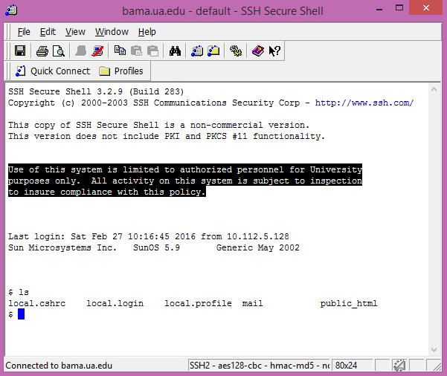
Unix Presentation – Competency 11 List files in root
Command – The {ls} command allows the user to list the files contained within the folder they are browsing.
Usefulness – This is perhaps the most useful, and most heavily utilized command thus far. The list feature allows the user to view the files present within which the user is browsing. It allows the user to visually verify any changes in structure or organization that have been made, as well as verify the presence of necessary files.

Slide 13

Unix Presentation – Competency 12 DRWRXR – Meanings
Command – As shown, the {ls –l} feature produces a detailed list of files within a directory, complete with what permissions have been enabled for various groups.
Usefulness – The locations of the letters in the permission string indicate various types of users and what permissions are enabled for each group.
d
Identifies item as directory (d), or file (-)
rwx
Permission available for the user.
r--
Permissions available for users in the same group.
--x
Permissions available for everyone else.
r – Permission to read or view the file or directory.
w – Permission to overwrite the file or directory.
x – Permission to execute or utilize the file or directory.

Slide 14

Unix Presentation – Competency 13 Search within a file
Command – The {grep} command, followed by a character string, followed by a file name, allows the user to search within the given file for the given character string.
Usefulness – The ability to display a list of instances of a particular character string is extremely useful for debugging and locating errors within the files themselves, and not merely with the organizational structure of the file system.

Slide 15

Unix Presentation – Competency 14 Logging out
Command – The {exit} command allows the user to safely log out of the system.
Usefulness – This command is extremely useful in terms of security. Having demonstrated the power of the Unix command prompt, and what possibilities exist for mayhem, it is important not to leave an open unsecured connection for anyone to utilize. Logging off is important to prevent any malicious interloper from doing all manner of damage, such as deleting entire file directories using a logged on secure server.

Slide 16
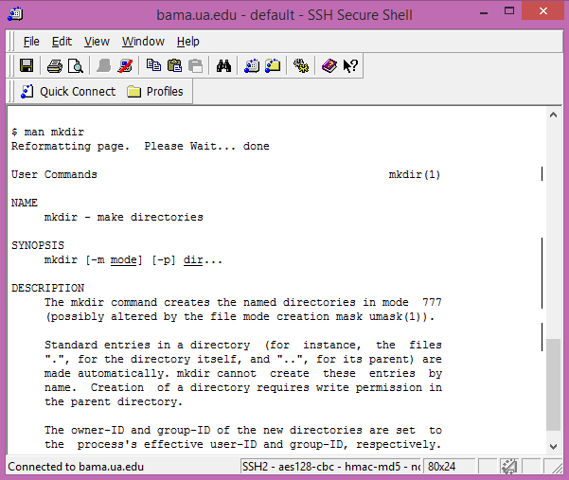
Unix Presentation – Bonus Competency Getting Help
Command – The {man} command followed by the name of the command you want information on displays a description of the command.
Usefulness – The {man} command opens up a whole new range of possibilities for learning potential, and enables the user to examine the usefulness of any command in the system individually in order to determine the correct course of action.

Slide 17
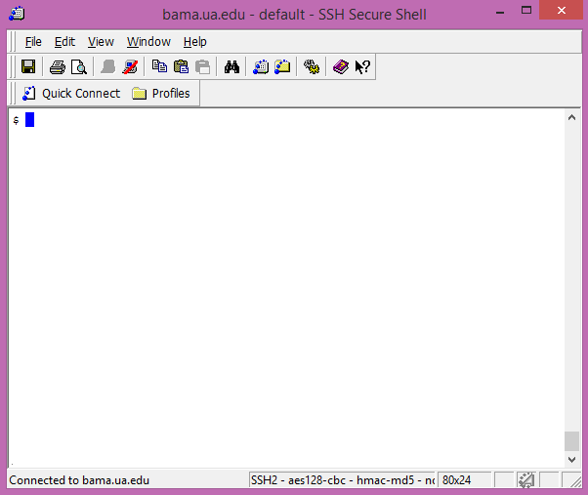
Unix Presentation – Bonus Competency Clear Screen
Command – The {clear} command clears the screen of any and all previous commands.
Usefulness – This command is particularly useful for security, as it erases previous commands so that any onlookers or interlopers can’t see what areas the user is working with, and what types of files the user has access to. Additionally, this command is useful simply for de-cluttering of the work station, in order to gain more grasp of the current task, dependent on the work style of the user.

